Slide 1
A prince, so long as he keeps his subjects united and loyal, ought not to mind the reproach of cruelty; because with a few examples he will be more merciful than those who, through too much mercy, allow disorders to arise. Is it better to be cruel rather than merciful, if being merciful allows disorder?

Slide 2
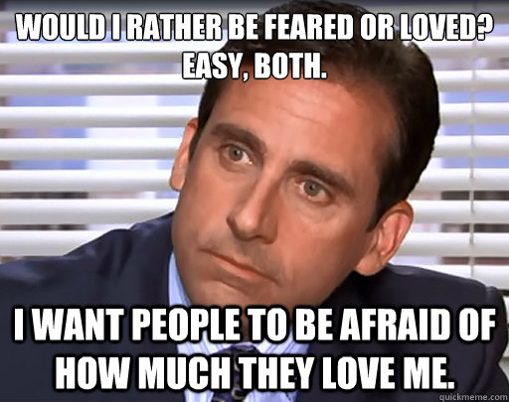
Machiavelli states that it is safer to be feared than loved, when, of the two, one must be chosen. (people who are scared of punishment will obey their leader) Is it better to be more loved than feared or more feared than loved?

Slide 3
Is it possible for someone to be in power if the people do not fear him? Explain your answer.
What ethical dilemmas might a leader face? Explain your answer.
Are ethics the same for a leader as they are for you and me?

Slide 4
THE STANFORD PRISON EXPERIMENT
Many people thought the brutality from this experiment had to do with personalities or the environment. What do you think? Why did the guards react the way they did?
Were the Stanford Prison guards Machiavellian?
Were any of their actions justifiable?
What can power do to a person?

