Slide 1
THE AMERICAN DREAM:
“That dream of a land in which life should be better and richer and fuller for everyone, with opportunity for each according to ability or achievement.” –James Truslow Adams

Slide 2
FREEDOM OF CHOICE

Slide 3
OPPORTUNITY TO CHANGE STATUS (SOCIAL MOBILITY)

Slide 4
GOOD FAMILY LIFE

Slide 5
Financial stability: RETIREMENT/Owning a home etc...

Slide 6
EQUALITY

Slide 7
REWARDED FOR HARD WORK

Slide 8
SAFETY/SECURITY

Slide 9
SUCCESSFUL CAREER

Slide 10
INDIVIDUALITY

Slide 11
RELIGIOUS FREEDOM

Slide 12
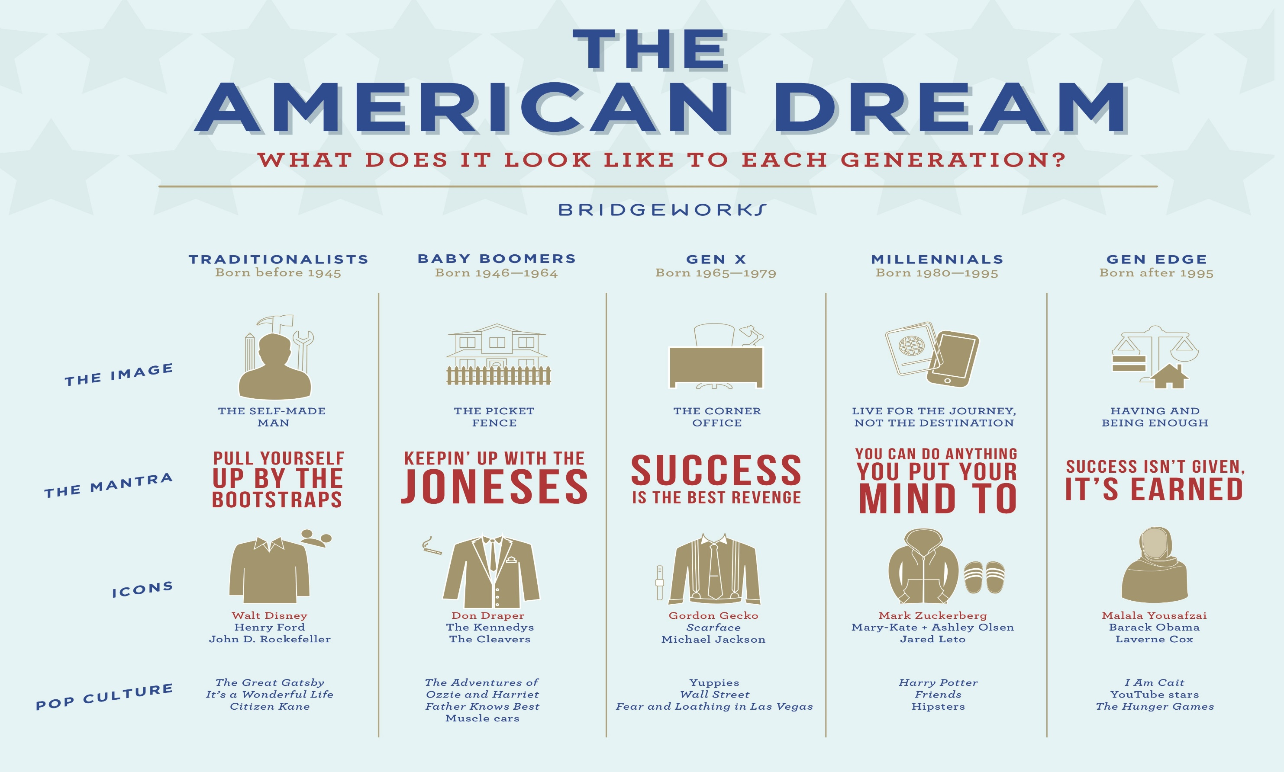

Slide 13
