Slide 1
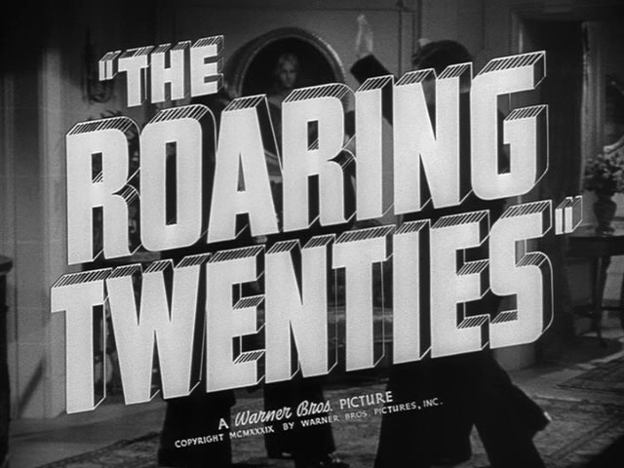

Slide 2
The 20’s: An Age of Transition
Changing Roles of Women Prohibition Urbanization KKK Growth Religious Controversies Immigration Concerns Music (Harlem Renaissance) Movies Sports Arts Literature Middle Class Growth Poverty Automobiles Mass Markets

Slide 3
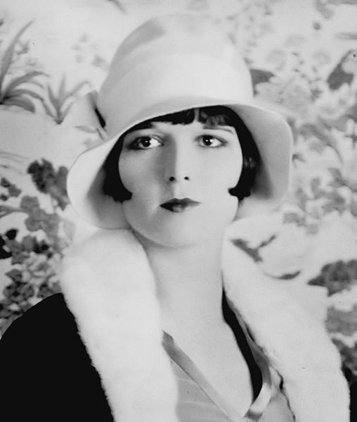
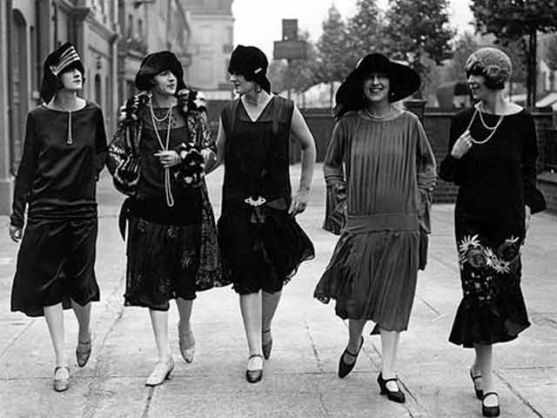
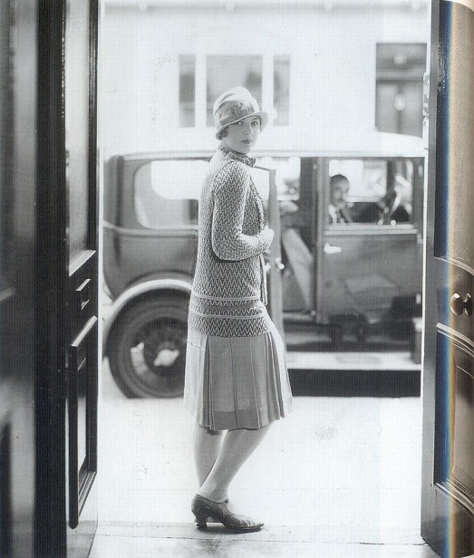
Changing Role of Women
The 19th Amendment(1920) gave women the right to vote.
During the Twenties 9 million women were employed and earned money on their own, many younger women used their money to enjoy themselves
Drank and smoked in public
The liberated young women were called" flappers"
Notes:
Women bobbed their hair
For the first time female alcoholism is a major problem.
In The Great Gatsby Jordan Baker is such a new type of woman

Slide 4
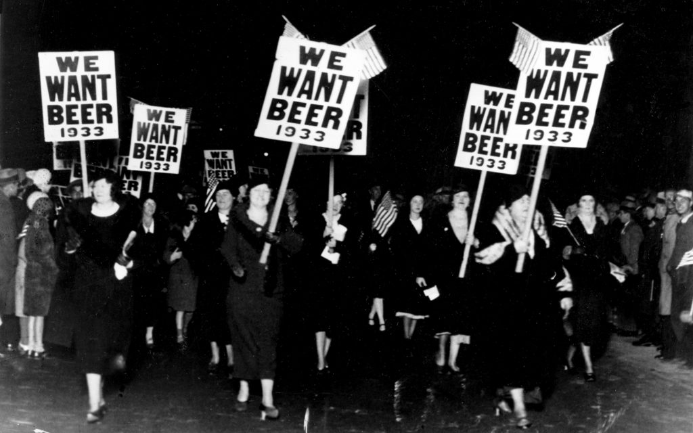
Prohibition
The 18th Amendment (1919) prohibited the sale and consumption of alcohol.
Although alcohol was illegal it was distributed through "bootleggers"
Alcohol was served in illegal night-clubs which were called "speakeasies"
Al Capone and other mafia members became an important part of American society
The St. Valentine's Day Massacre
Notes:
bootlegging means the production and sale of liquor.

Slide 5
Urbanization and the Economy
Mass migration from rural areas to cities
“Parties were bigger, the pace was faster, the buildings were higher, the morals looser” (Fitzgerald)
Rapid growth of industry and mechanization: unlimited progress
America became the richest nation on Earth and a culture of consumerism was born
Materialism achieved too quickly. Thus, lacking spiritual life/purpose.
Notes:
Henry Ford, assembly lines, radios, and technological advances played a vital rode in the economy.

Slide 6
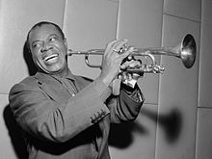
Race and the Harlem Renaissance
In the 1920s, the great migration of blacks from the rural South to the urban North sparked an African–American cultural renaissance
The Harlem Renaissance marked the first time that mainstream publishers and critics turned their attention to African–American literature, music, art and politics.
Langston Hughes-Louis Armstrong-Duke Ellington
The revival of the KKK in the early twentieth century reflected a society struggling with the effects of industrialization, urbanization, and immigration.
Notes:
from Asia and Eastern Europe. Klansmen complained that these immigrants were taking jobs away from whites and diluting the imagined “racial purity” of American society. Given that the country had been populated by immigrants from the beginning, such ideas of racial purity were complete myths.

Slide 7
The Lost Generation
The Lost Generation refers to the generation of artists, writers, and intellectuals that came of age during the First World War (1914-1918) and the “Roaring Twenties.”
Fitzgerald- Coined “The Jazz Age”
Charlie Chaplin- Comedian, Actor and filmmaker
Coco Channel- First designer to make pants for women
Charles Linderbergh- First solo non-stop flight from NY to Paris
Babe Ruth- Record for hitting 60 home runs in one season
Henry Ford- Founder of Ford
Walt Disney

Slide 8
Optimism
Business, change and innovation, laissez faire- economy
Rapid growth of industry and mechanization
Even skeptics believe in progress and in solving of problems: new" Golden Age" for America
The idea of “The American Dream”

Slide 9
Controversy
The 20s were referred to as the decade of "decline and degradation"
Americans are caught up in a "surge of materialism," people who had failed to grasp the meaning and significance of life.
they feel disillusioned or disenchanted, they lost faith in life and in the possibility of social progress that caused their absolute lack of interest in politics.
Many of the lost generation expressed doubt and cynicism in their artistic endeavors.

Slide 10
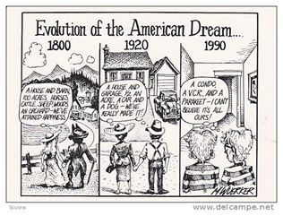
The American Dream
Rags to Riches
The belief that anyone, regardless of where they were born or what class they were born into, can attain their own version of success in a society where upward mobility is possible for everyone.
“The American dream is achieved through sacrifice, risk-taking and hard work, not by chance.

Slide 12
Gatsby and The American Dream
Several characters have an illusion of the “American dream” but it is a false perception of the reality of it.
Shows that the unrestrained desire for money and pleasure surpassed more noble goals
American aristocracy—families with old wealth—scorned the newly rich industrialists and speculators
Poverty-Discrimination-Exploitation-Hypocrisy-Corruption-Suppresion
Notes:
A highly symbolic meditation of the 1920s, in particular the disintegration of the American dream in an era of unprecedented prosperity and material excess.

Slide 13
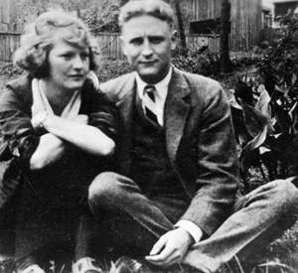
F Scott Fitzgerald
Went to private schools and attended college at Princeton
Leading figure in a dramatic society, The Triangle Club
Neglected his studies – flunked out and joined the army
While stationed in Alabama in 1918 he met and fell in love with his future wife Zelda Sayre
She refused to marry him due to his lack of success
In 1919 he is discharged from the Army
1920 - published his first novel This Side of Paradise
Zelda agreed to marry him
Notes:
This Side of Paradise – it made him famous!
Called the “prince and princess” of the generation

Slide 14
Fitzgerald Continued
By 1922 he is an alcoholic
In 1930, Zelda had the first of several mental breakdowns
Sent to sanitarium in Switzerland; she spent the rest of her life in both inpatient and outpatient care
By 1931 Fitzgerald’s writing was an off and on practice because he was trying to take care of his ailing wife
By 1936 the marriage was virtually over and Zelda moved permanently to Highland Hospital

Slide 15
The End of Fitzgerald
1935-37 is known as the “crack up” in Fitzgerald life
Decent into alcoholism
In debt
Unable to be a present father for Scotty (sent to boarding schools)
Fitzgerald went to Hollywood in 1937 to try his luck at screenwriting
He won a substantial contract with MGM, but still wasn’t financially viable due to his debt
Fitzgerald died of a heart attack in 1940
Zelda died in a fire in 1948
Notes:
His 1924 work, The Great Gatsby has secured him a place in American History being called the example that “defines the classic American novel”

