Slide 1
McCarthyism AND THE red SCARE

Slide 2
What was the Red Scare?
Hysteria over the perceived threat posed by Communists in the U.S. became known as the Red Scare. (Communists were often referred to as “Reds” for their allegiance to the red Soviet flag.)
Federal employees and many Hollywood stars were put on trial to determine whether they were loyal to the government.
HUAC (House Un-American Activities Committee) as well as Joseph R. McCarthy investigated allegations.

Slide 3
Who was Joseph McCarthy?
McCarthy was a Republican U.S. Senator
Used hearsay and intimidation to establish himself as a powerful and feared figure
In seek of reelection he sparked his political presence by claiming 205 communists infiltrated the U.S. State Department, now termed as “The Red Scare”
Accused leftists, intellectuals and artists

Slide 4
Red Scare Propaganda

Slide 5
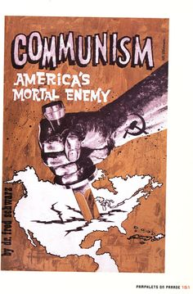
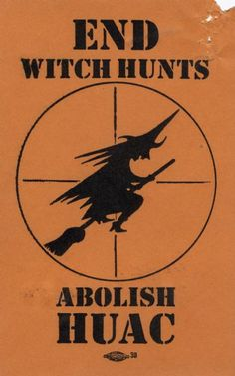

Slide 6
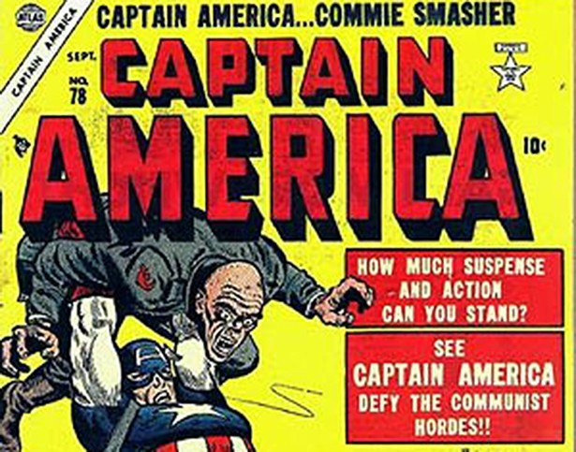
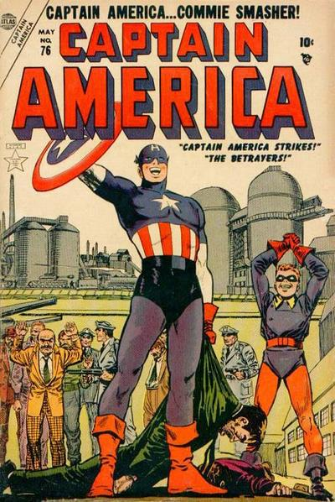

Slide 7
Captain America
Captain America has always been a freedom fighter, but what kind of freedom he fights for depends on the era of modern American history.
“The communists are the Nazis of the 1950’s” -Steve Rogers aka Captain America
For nine months—from December 1953 to September 1954—Captain America was known as the Commie Smasher, along with his World War II sidekick, James “Bucky” Barnes.

Slide 8
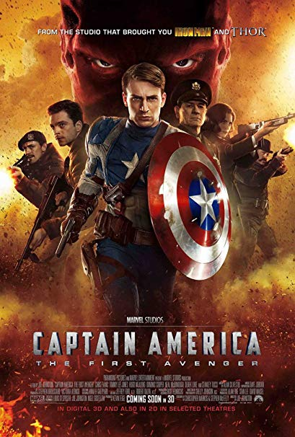
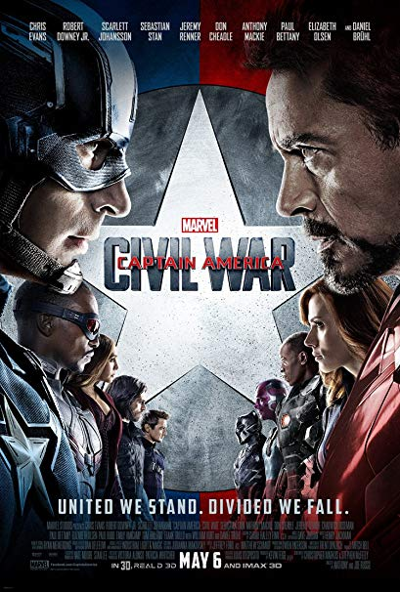

Slide 9
In a 2006-2007 storyline called “Civil War,” the superheroes of the Marvel universe are forced to register with the U.S. federal government.
The storyline is an allegory for the Patriot Act, a result of the 9/11 terrorists attacks on American soil.
The Cap in The Winter Soldier is one who fights for what he feels is best for the American people. "My job is to make tomorrow’s world better. Always has been. There’ll always be something to fight for. And I’ll always be a soldier.“
Notes:
Two sides are formed among the heroes: the side that supports it, led by Iron Man, and the side that opposes it because it violates civil liberties, led by Captain America.
The beauty of Captain America is that he is and always has been a symbol of the American dream. But that dream encompasses what German psychologist Erich Fromm called the basic human dilemma, which is the conflicting desire for both security and freedom.
What role should the government play in modern America?
When does public safety become an invasion of privacy? Metaphor for gun control?

Slide 10
HUAC AND THE ACCUSED
House Un-American Activities Committee (HUAC) convened hearings in Washington, D.C., to investigate activities in the entertainment industry.
41 screenwriters, directors and producers were subpoenaed. Most witnesses were “friendly” — that is, willing to respond to the committee’s central question: “Are you now or have you ever been a member of the Communist Party?”
“friendly” witnesses were those who were willing to identify others in the motion-picture industry as confirmed or suspected Communists. Some named names to save their own careers, others did so out of true political conviction
Those who confessed to membership were offered the opportunity to name “fellow travelers,” thereby regaining their good standing with the committee and, by extension, the American film industry.
As individuals cooperated and "named names," the list grew. Altogether some 320 people in the entertainment industry were blacklisted for suspected involvement in "subversive" activities.

Slide 13
Statements From the Accused:
Actor Adolphe Menjou declared, "I am a witch hunter if the witches are Communists. I am a Red-baiter. I would like to see them all back in Russia.“
Reagan testified that a small clique within his union was using "communist-like tactics" (Later his first wife, actress Jane Wyman stated in her biography with Joe Morella [1985] that Reagan's allegations against friends and colleagues led to tension in their marriage, eventually resulting in their divorce)

Slide 14
The Ten Witnesses
Ten witnesses — all current or former party members — banded together in protest, refusing to cooperate on First Amendment grounds (freedom of speech, right of assembly, freedom of association) and affirming that HUAC disagreed
It found the so-called Hollywood Ten in contempt of Congress, fined them each $1,000 and sentenced them to up to a year in federal prison.
All 10 artists also were fired by a group of studio executives — and the era of the Hollywood blacklist began.

Slide 15
Additional Information
Critics claimed that HUAC’s tactics amounted to a witch hunt that trampled on citizens’ rights and ruined their careers and reputations. These critics argued that most people who were called before the committee had broken no laws, but instead were targeted for their political beliefs or for exercising their right to free speech. Supporters of the committee, on the other hand, believed that its efforts were justified given the grave threat to U.S. security posed by communism.

Slide 16
Questions about McCarthyism
Note that he said “Capitalized,” What does it mean that Joseph McCarthy was able to capitalize on his accusations?
Why would Arthur Miller write a play about the Salem Witch Trials?

Slide 17
THE SALEM WITCH TRIALS

Slide 18
What did Puritans believe?
Strict, rigid moral code
All sins—from sleeping in church to stealing food—should be punished. They also believed God would punish sinful behavior. When a neighbor would suffer misfortune, such as a sick child or a failed crop, Puritans saw it as God’s will and did not help.
The Devil was as real as God. Everyone was faced with the struggle between the powers of good and evil, but Satan would select the weakest individuals—women, children, the insane—to carry out his work.
Those who followed Satan were considered witches. Witchcraft was one of the greatest crimes a person could commit, punishable by death.

Slide 19
Additional Beliefs
The Bible was central to their worship.
Their church services were simple. The organ and all musical instruments were forbidden. Puritans sang psalms a cappella.
The spiritual health and welfare of the community as a whole was necessary. The integrity of the community demanded religious conformity.
God had chosen a few people as “the elect” for salvation and the rest of humanity was condemned to eternal damnation.
No one really knew if he or she was saved or damned. This lead to a state of constant spiritual anxiety searching for signs of God’s favor or anger.
A person could not do anything to be saved (faith not works)

Slide 20
How did others view Puritans?
As they gained strength, Puritans were portrayed by their enemies as hairsplitters who slavishly followed their Bibles as guides to daily life
They were caricatured as licentious hypocrites who adopted a grave aspect but cheated the very neighbors whom they judged inadequate Christians.
Appeared in drama and satire as secretly lascivious purveyors of feigned piety.
Notes:
The literacy rate was high, and the intensity of devotional life, as recorded in the many surviving diaries, sermon notes, poems, and letters, was seldom to be matched in American life. The Puritans’ ecclesiastical order was as intolerant as the one they had fled.

Slide 21
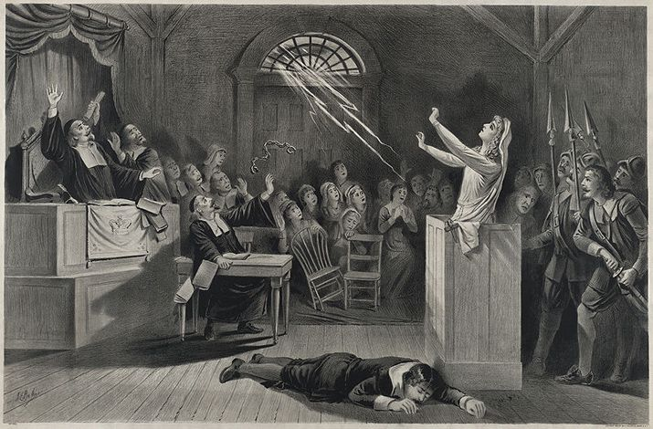

Slide 22
Happenings in the Crucible
Reverend Parris' daughter Elizabeth, age 9, and niece Abigail Williams, age 11, started having "fits." They screamed, threw things, uttered peculiar sounds and contorted themselves into strange positions, and a local doctor blamed the supernatural. Another girl, Ann Putnam, age 11, experienced similar episodes. On February 29, under pressure from magistrates Jonathan Corwin and John Hathorne, the girls blamed three women for afflicting them: Tituba, the Parris' Caribbean slave; Sarah Good, a homeless beggar; and Sarah Osborne, an elderly impoverished woman.

